Slide 1
Research on the Risks of Investing in the Aviation Industry
(Phase 1 Project)

Slide 2
Introduction
Seryabiz Ltd considered diversifying its investment portfolio and dove into investigating several ventures that would ensure returns at a manageable risk level. The aviation industry was the selected venture; therefore, research was to be carried out around the industry's risks, and insights provided, to the newly formed aviation department to enable them to make informed decisions on moving forward.

Slide 3
Goals
Determine if the investment into the Aviation Industry is Viable.
Select the aircraft with the least risk for a starting investor in the field.
Decide on the sector into which the company should invest.

Slide 4
Data
To carry out our research, we used data from the National Transportation Safety Board that includes aviation accident data from 1962 to 2023 about civil aviation accidents and selected incidents in the United States and international waters.

Slide 5
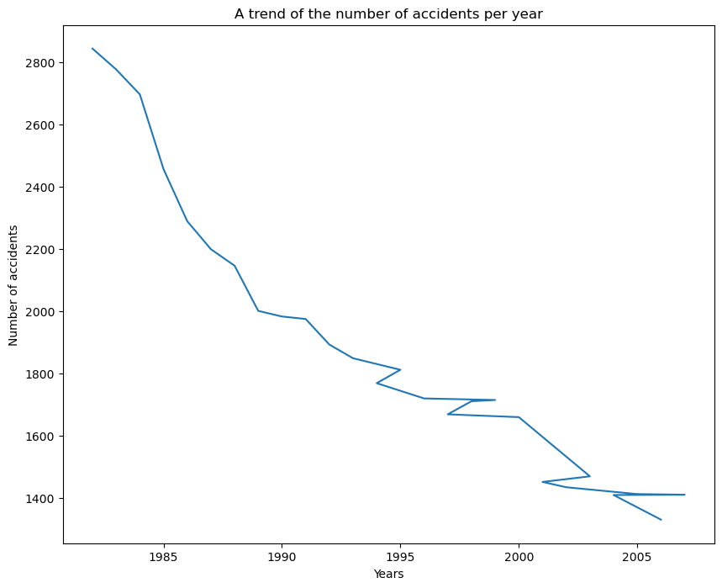
Data Analysis

Slide 6
From the line graph shown above. It can be clearly seen that the number of accidents have been dropping over time, indicating that the aviation industry has been getting safer with more safety measures being adopted.
Recommendation 1: Seryabiz Ltd should proceed to invest in the industry as it is safer now than before and the trend indicates that it will continue to improve

Slide 7
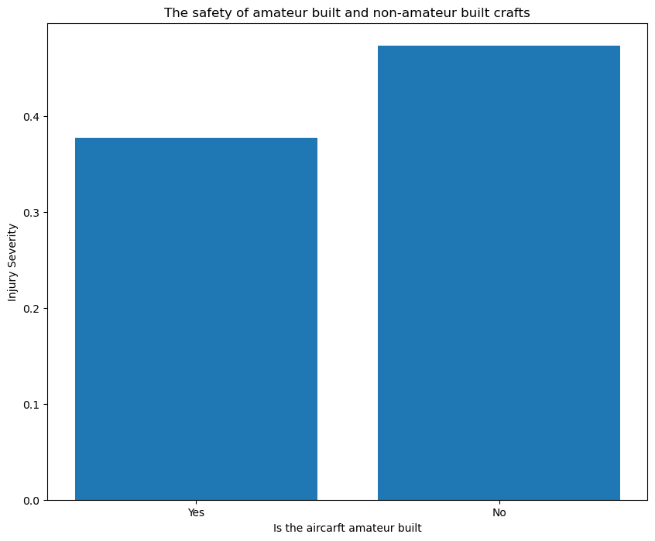

Slide 8
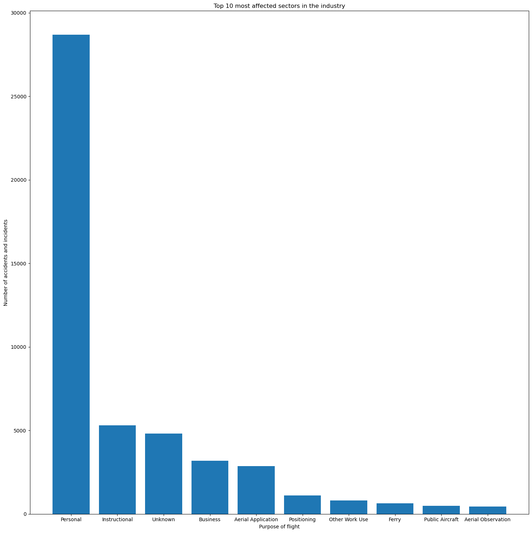

Slide 9
The visuals above show that amateur built aircrafts are safer compared to aircrafts that are not amateur built and the second bar graph indicates that the personal airplanes are more rampant.
Recommendation 2: The company should purpose to purchase amateur built aircrafts for the investments.
The personal flights are the most affected sector of the aviation industry. The business sector is the advisable field as it is less affected and also has more customers compared to the other sectors.

Slide 10
Aircraft_damage | Destroyed | Minor | Substantial | Total | Durability
make
Kewley | 0 | 0 | 1 | 1 | 0.0
Masnic | 0 | 0 | 1 | 1 | 0.0
Mason, Jack A. | 0 | 0 | 1 | 1 | 0.0
Masselink | 0 | 0 | 1 | 1 | 0.0
Massey | 0 | 0 | 2 | 2 | 0.0
Mastopietro | 0 | 0 | 1 | 1 | 0.0
Matey | 0 | 0 | 1 | 1 | 0.0
Mathew M. Kerr | 0 | 0 | 1 | 1 | 0.0
Mathews | 0 | 0 | 1 | 1 | 0.0
Matter | 0 | 0 | 1 | 1 | 0.0
Recommendation 3: The most durable make is Kewley and the data frame above shows the top ten most recommended makes.

Slide 11
Conclusion
Our research has resulted in 4 recommendations that will enable the aviation department advise the company. The investment in the industry is a viable option as the risk of accidents has significantly reduced overtime. The company should invest in the business sector of the industry and should buy amateur built, Kewley make for a start. This will is an investment with the least risk in the industry.

